Slide 1
<number>
House Price Predictor
Predict The Market Value of Properties
Group no : 10
Group Members
ALDRIN SIMENTHY
GREESHMA PRASAD P
JYOTHIS K S
VISMAYA DINESH
Guided by
Vivek m v

Slide 2
Contents
Introduction
Project Objective
Technology Used
Tools Used
Software Requirements
How It Works?
Diagrams
Graphical User Interface

Slide 3
Introduction
Problems faced during buying a house:
Buying a house is a stressful thing.
Buyers are generally not aware of factors that influence the house prices.
Many problems are faced during buying a house.
Hence real estate agents are trusted with the communication between buyers and sellers as well as laying down a legal contract for the transfer. This just creates a middleman and increases the cost of houses.

Slide 4
<number>
For overcoming the drawback, We a need for an updated and automated system.
The objective of our project is to reduce the problems faced by the customer.
Proposed work aims at predicting the availability of houses based on different features of the houses and the facilities available nearby the location of the houses, that are:
1. Number of bedrooms (1BHK, 2BHK and 3BHK etc..).
2. Number of bathrooms, carpet area, built-up area, the floor etc..
3. Age of the property.
4. Education facilities.
5. Medical facilities.
6. Transport facility such as availability of bus, trains and flights.
7. Shopping facility such as small markets, general stores, shopping malls.
8. Analyse the crime rate

Slide 5
Project Objective
Our project is a machine learning app, based on certain specifications of your future home it will try to guess the most accurate price.
Our project, predicting the house prices in Kochi, Chennai, Bangalore, Mumbai, Delhi and Kolkata.
Different models are used to predict the property price.
Our models are evaluated on the Root-Mean-Squared-Error (RMSE).
The result of this research proved gives an accuracy of more than 90%.

Slide 6
Models Used
Ridge Regression
Lasso Regression
Elastic Net Regressor
XG Boost
Extra tree Regressor
Bagging Regressor
Support vector Regressor(SVR)
Gradient Boosting
Light GBM
To make final predictions, We blended above models predictions together to get more robust predictions. Blending model using best models.

Slide 7
Technology Used
Machine Learning
Machine learning is a method of data analysis that automates analytical model building. It is a branch of artificial intelligence based on the idea that systems can learn from data, identify patterns and make decisions with minimal human intervention.
In general, any machine learning problem can be assigned to one of two broad classifications:
Supervised learning
Unsupervised learning.

Slide 8
<number>
Python
Python is an interpreted, high-level and general-purpose programming language. Python's design philosophy emphasizes code readability with its notable use of significant indentation.
Flutter
Flutter is an open-source UI software development kit created by Google. It is used to develop applications for Android, iOS, Linux, Mac, Windows, Google Fuchsia, and the web from a single codebase.

Slide 9
Tool Used
TensorFlow
Keras
Scikit Learn
Kivy
Flask

Slide 10
Software Requirements
Platform : Android
Operating System : Android – Version 6.0 above ( API 23 above )
Hardware : Smartphone at least 1GB RAM
Android SDK 23
Android Studio
Flutter SDK
Anaconda
PyCharm

Slide 11
How It Works ?
Collection of data
First step was to collect data, We collected data from different sources and merged them together to form our data set.
Then, Data preprocessing is the process of cleaning our data set. There might be missing values or outliers in the dataset.
Since the data is broken down into two modules: a Training set and Test set, we must initially train the model. The training set includes the target variable.
The different types algorithm is applied to the training data set.
Based on the generated graphs we predict the cost of the Houses.

Slide 12

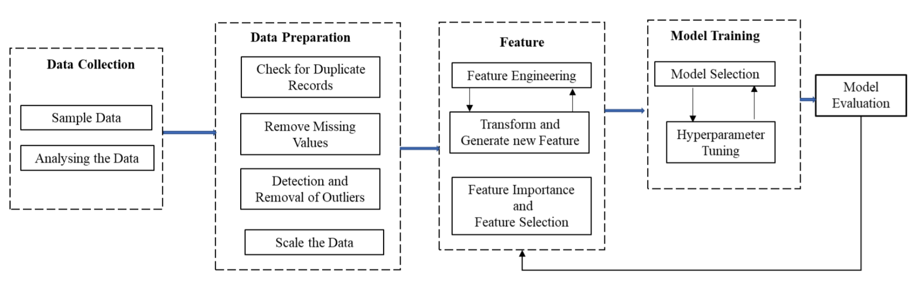
<number>
Research framework for the housing price problem.

Slide 13
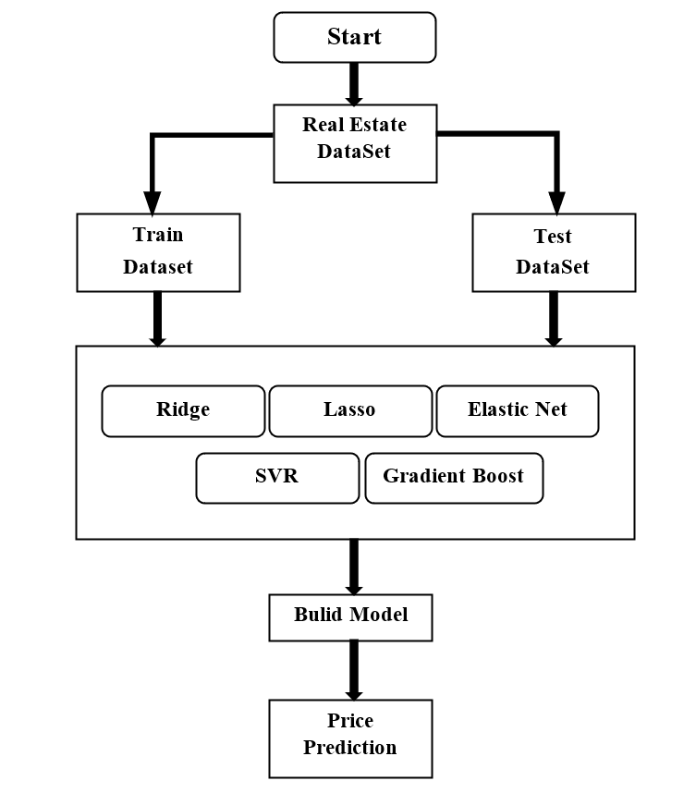
<number>
The Generic Flow of Development

Slide 14
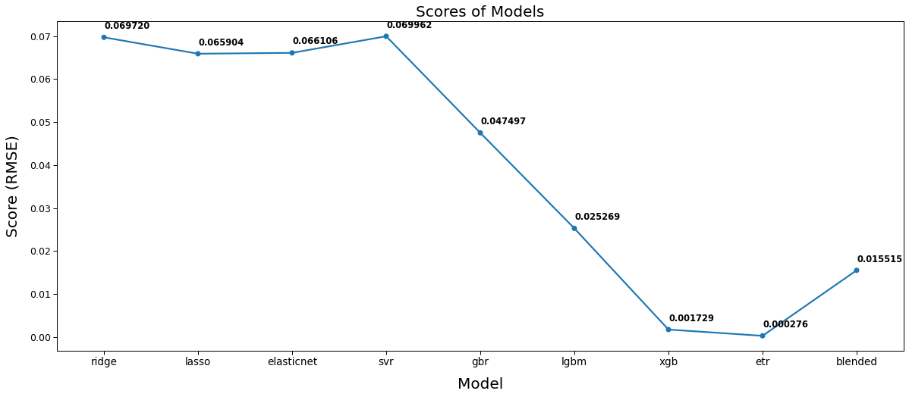
<number>
Predictions from All Models

Slide 15
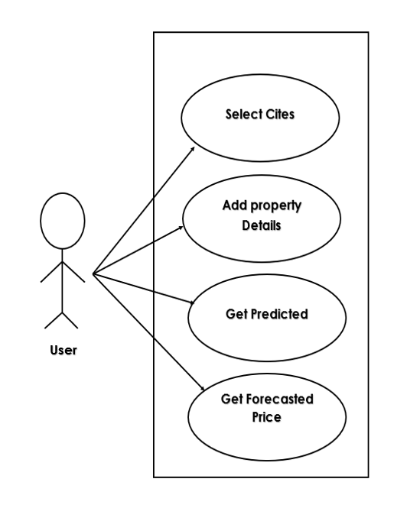
<number>
Use Case Diagram

Slide 16
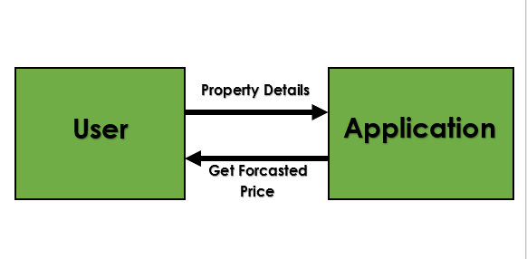
<number>
Context Diagram

Slide 17
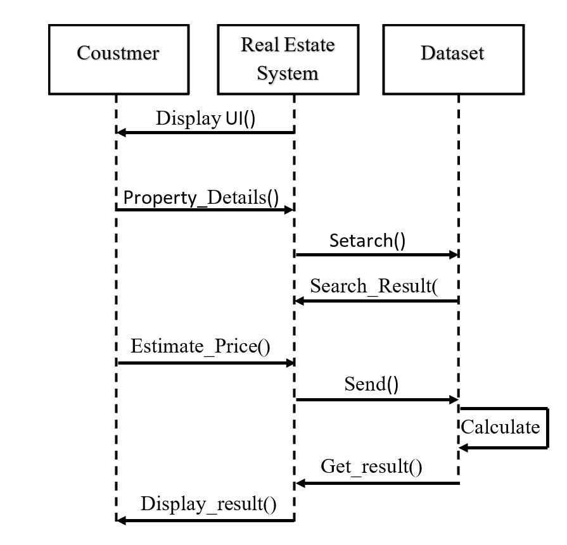
<number>
Sequence Diagram

Slide 18
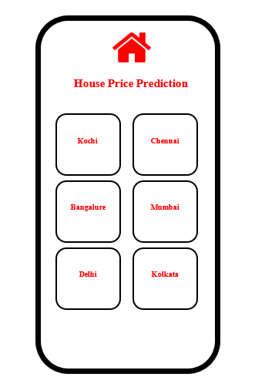
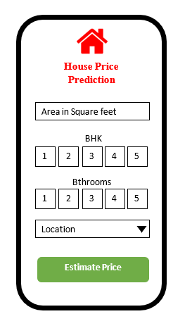
Android Application
<number>
Graphical User Interface

Slide 19
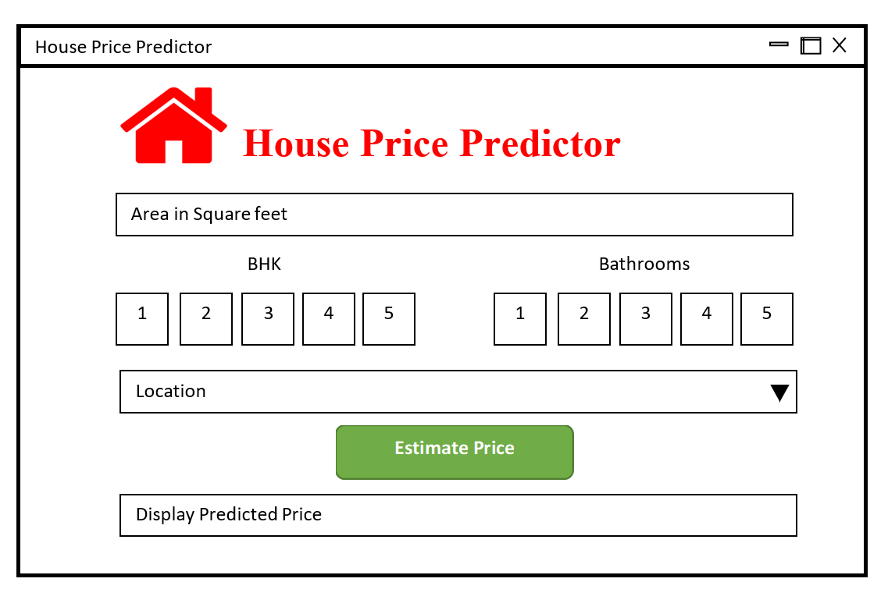
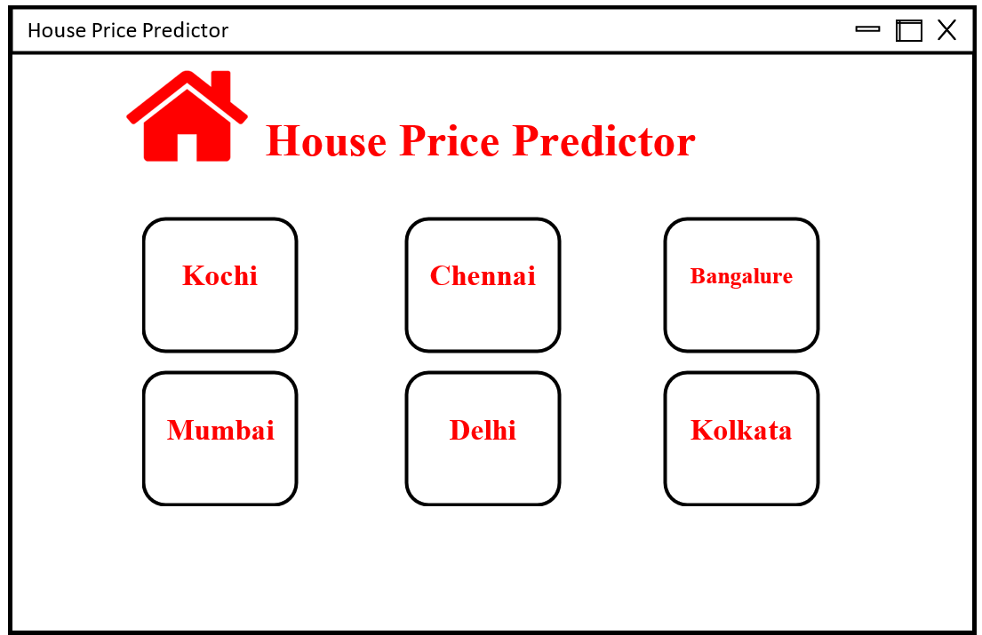
<number>
Web Application

Slide 20
<number>
THANK YOU

